Slide 1
Basket Analysis

Slide 2
Purpose of Basket data analysis
To understand the customer purchasing pattern in the supermarket.
Identify the frequent items sold in the supermarket.
Identify the frequent items that are sold together in the supermarket.
With the insights, formulate the strategy that can be followed in boosting the item sales.

Slide 3

Problem Statement
Identify the items and the itemset that creates a huge impact in driving the revenue and profit growth of the Supermarket business.

Slide 4
Supermarket Transaction data
The transaction dataset contains 9835 rows and 1 column. Each row is a transaction and represents the items that are sold in that transaction.
Grocery transaction dataset

Slide 5



Explanatory Data Analysis

Slide 6


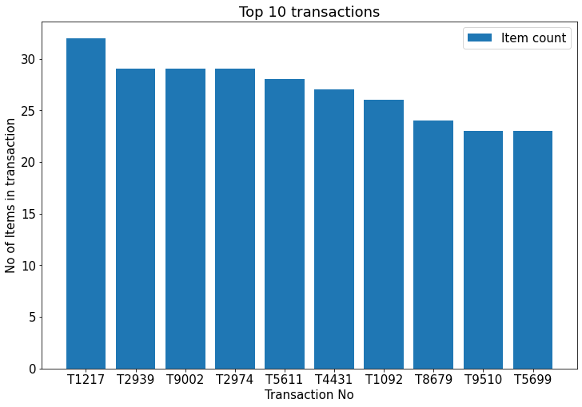
Observation
The maximum number of items sold in a transaction is 32.

Slide 7
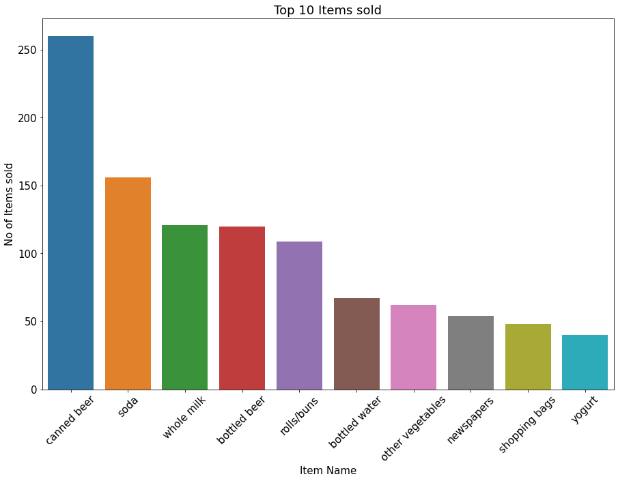
Observation
There are 169 unique items in the dataset.
Canned beer is the top selling item in the supermarket.

Slide 8
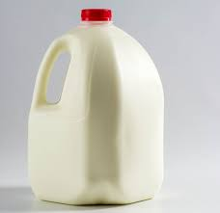
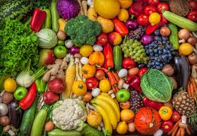
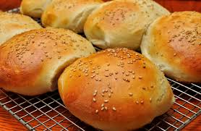
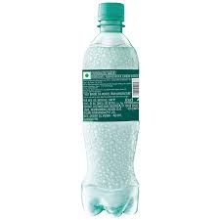

Top 5 frequent individual Items sold
Whole Milk
Vegetables
Rolls/Buns
Soda
Yogurt

Slide 9
Top 5 frequent Itemsets

Slide 10

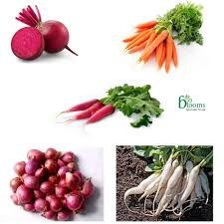
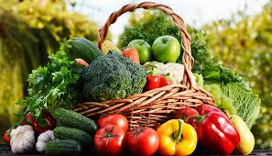
Itemset 1
Citrus fruits
Root vegetables
Vegetables

Slide 11

Itemset 2
Tropical fruits
Root vegetables
Vegetables

Slide 12

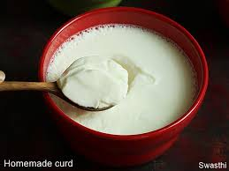
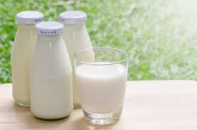
Itemset 3
Yogurt
Curd
Whole Milk

Slide 13
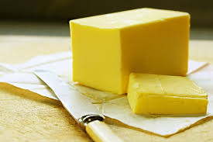
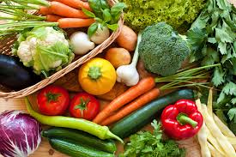
Itemset 4
Butter
Vegetables
Whole Milk

Slide 14
Itemset 5
Tropical fruits
Root vegetables
Whole Milk

Slide 15
Conclusion
It's been observed that Whole Milk is the top selling item in the Supermarket.
Customer had been purchasing Whole Milk when purchased either of the below items,
Citrus fruits
Root vegetables
Other vegetables
Yogurt
Butter
Domestic eggs

Slide 16
Recommendations
Supermarket can introduce promotional discounts by clubbing Whole Milk with its identified frequent associated products .
Also Supermarket can place the Whole Milk and its associated products in the adjacent shelves so that customers can buy them together.

Slide 17
Thank you !!!

